Slide 1

Finding Trends in Finding Forever Homes A data analysis and predictive model of foster care trends in The Midwestern United States
Project 3 | Group 7
Hannah Duncan | Geoffrey Johnston | Timothy O’Malley | Kristan Pruett | Ge (Melody) Yu
Notes:
Line spacing + Page numbers

Slide 2

Introduction
400,000.
A number so large, it is almost hard to fathom that many of any one thing.
A number that is downright staggering when paired with the following information:
“Each year, more than 400,000 children experience
foster care in the United States.”
-Voices for Children (www.speakupnow.org)

Slide 3
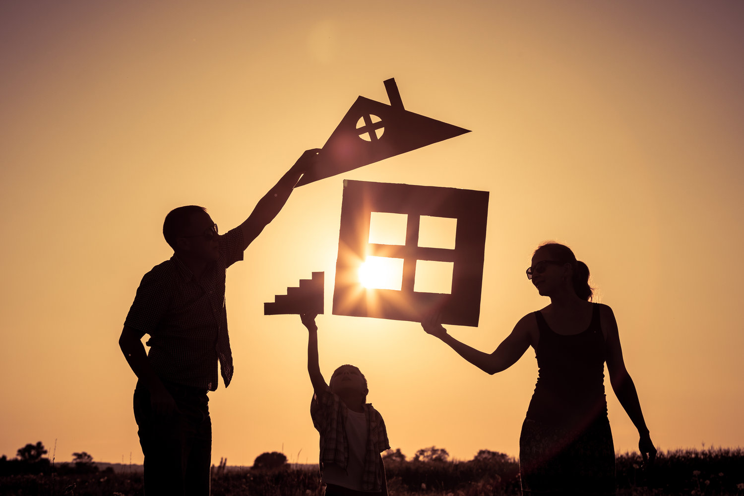
Introduction
Foster care in America is becoming more and more of a pressing issue on communities around the country. State agencies are becoming more and more saturated with children requiring foster care with not enough families to take in the children affected by separation.
Our goal is to be able to predict the future need of foster families in The Midwestern United States based on data obtained from 2010-2019.

Slide 4
Interactive Website
We have developed a website illustrating the current trends in America for foster care from 2010-2019
The interactive website shows data compiled for all 50 states showing the number of children in care, the number of adoptions and the number of terminations of parental rights (TPR) over the 10-year period
This website will also show predictions for foster care in the future for selected states
https://gemelodyyu.github.io/Trends-in-Foster-Care-and-Adoption/
Notes:
Line spacing + Page numbers

Slide 5
Our Motivations
Resources available for foster families are limited already; by projecting out the need in the future agencies can get a “heads up” as to what resources will be available in the future
While one person or one family may not be able to make a huge impact on the nation or the world, everyone can make a difference in their own corner of the world in their own way; foster care is one option for “making a difference”
Most people in the community and/or the nation are unaware of the need for foster care families and the implications they can have on the life of one or more children in their lifetime
America is the most prosperous nation in the world, yet we have a problem with the breakdown of family units resulting in a glut of children needing care. If we can get on top of this problem in America we can then affect change in the rest of the world by providing assistance and resources where nations are not as prosperous and the need is potentially even greater

Slide 6
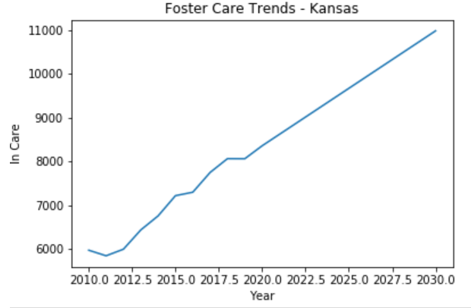
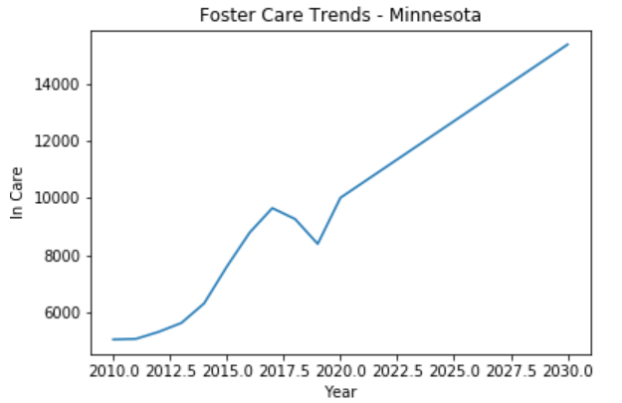
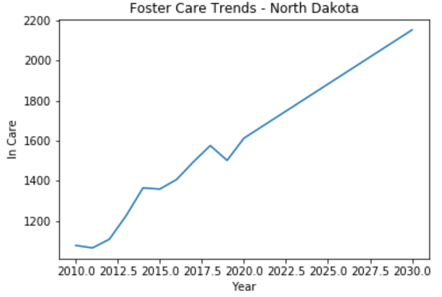
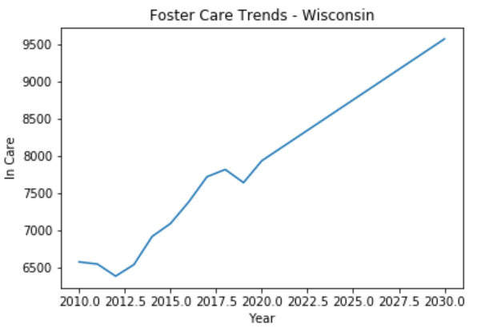
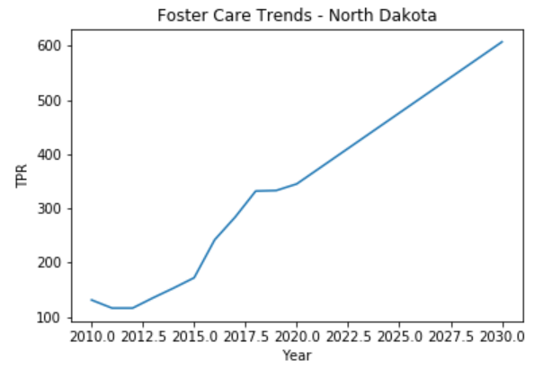
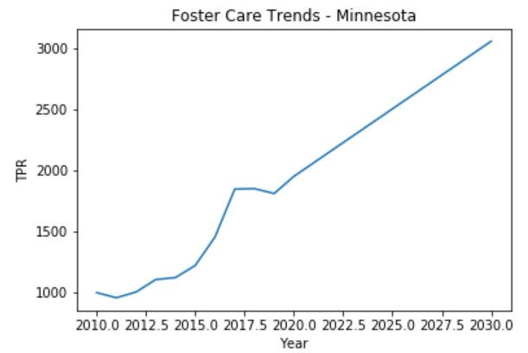
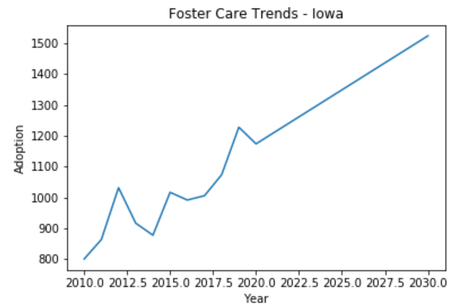
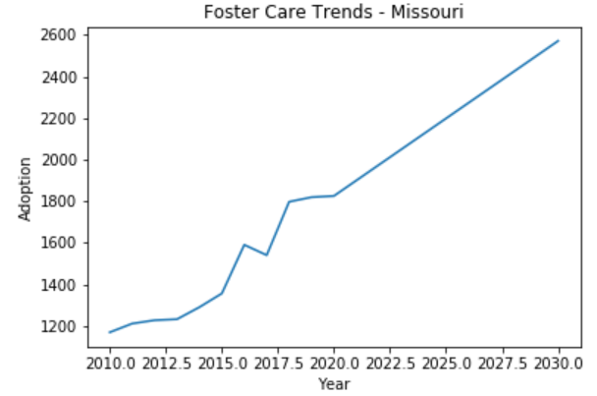
Our Predictions
Using a regression analysis from SkLearn we have developed a model to predict what the foster care needs will be in 5, 10, and 20 years from now in selected states. We will be looking at predicting the number of children in care as well as TPR predictions for the future (which can also be used to estimate group home needs for children that age out of the foster system without being adopted). Our analysis also included predicting the number of adoptions by state as well. We chose some Midwestern states as a start, but the analysis could be carried out by state for every state in the nation
Notes:
Line spacing + Page numbers

Slide 7
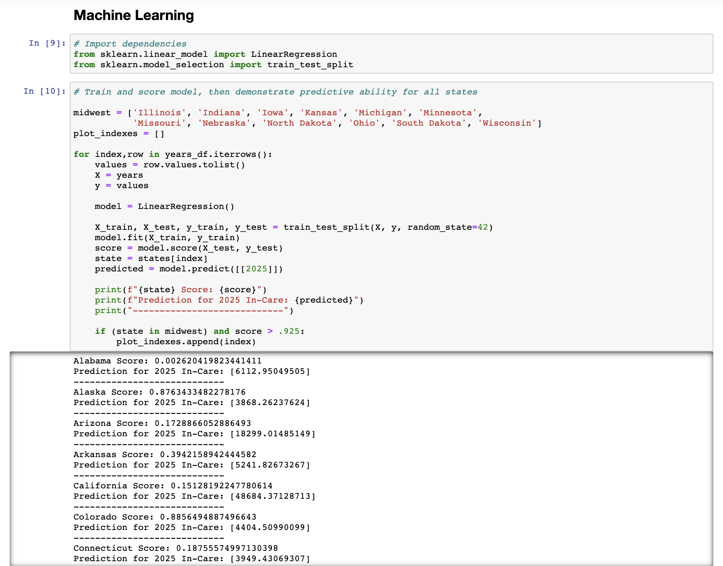
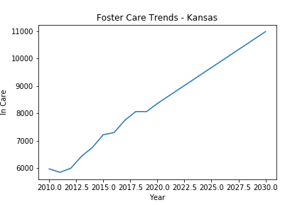
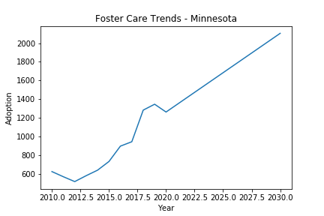
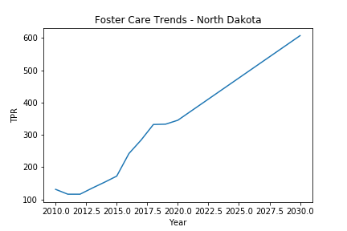
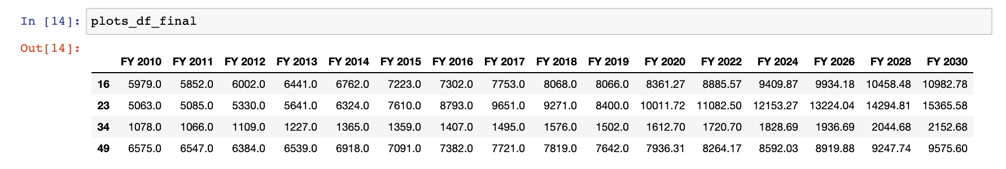
Machine Learning: Trends

Slide 8
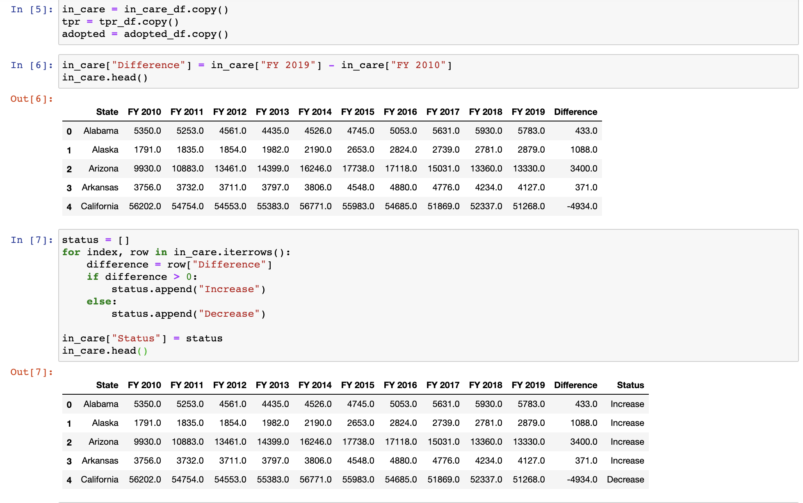
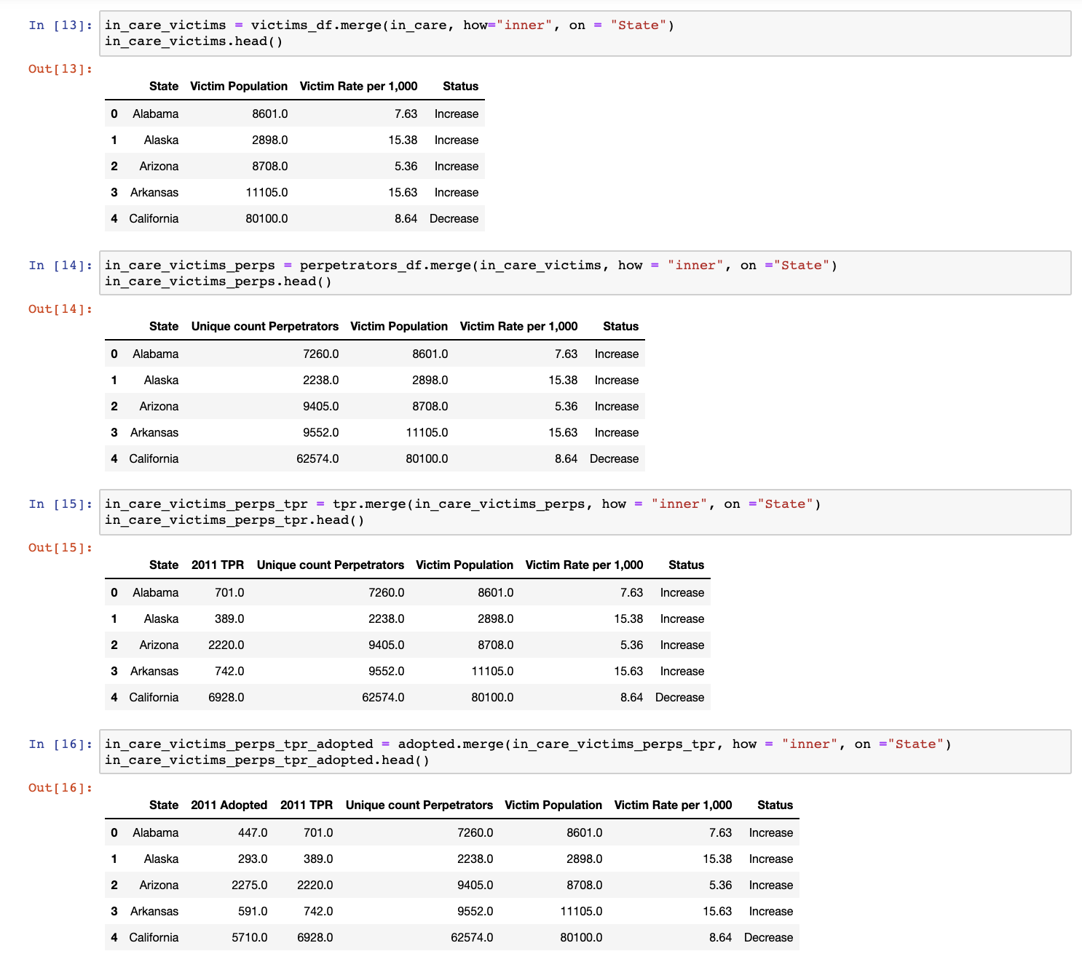
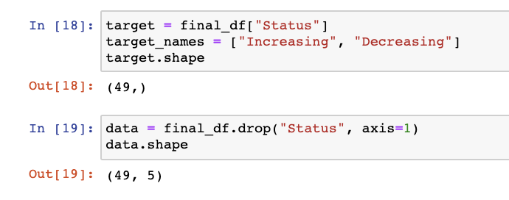
Data Cleaning
Convert numerical data to categorical data
Rename columns, filter dataset to desired features
Joins, joins, and more joins…
Shape and reshape

Slide 9
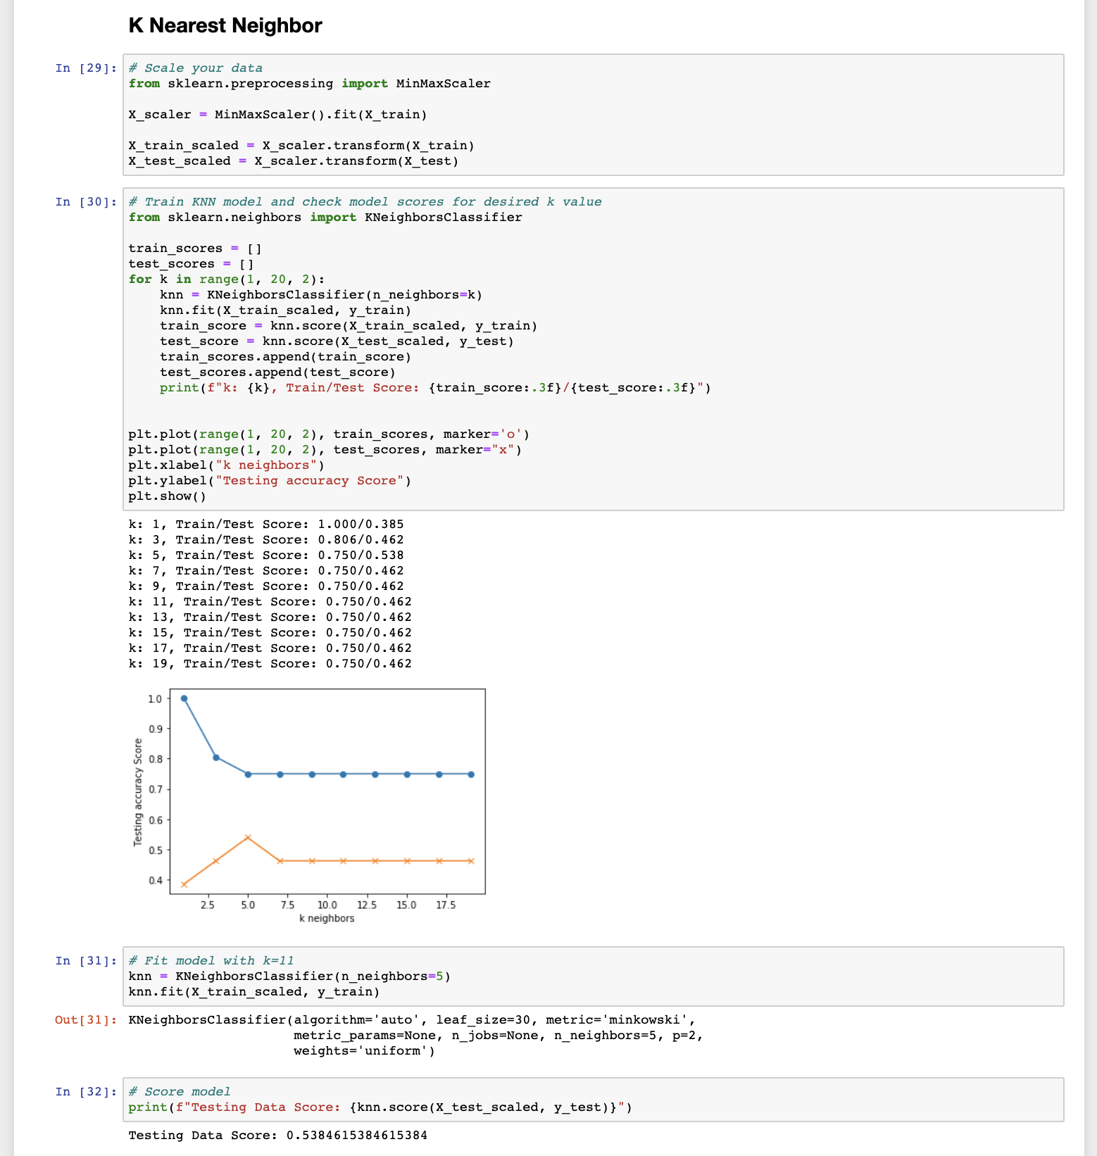
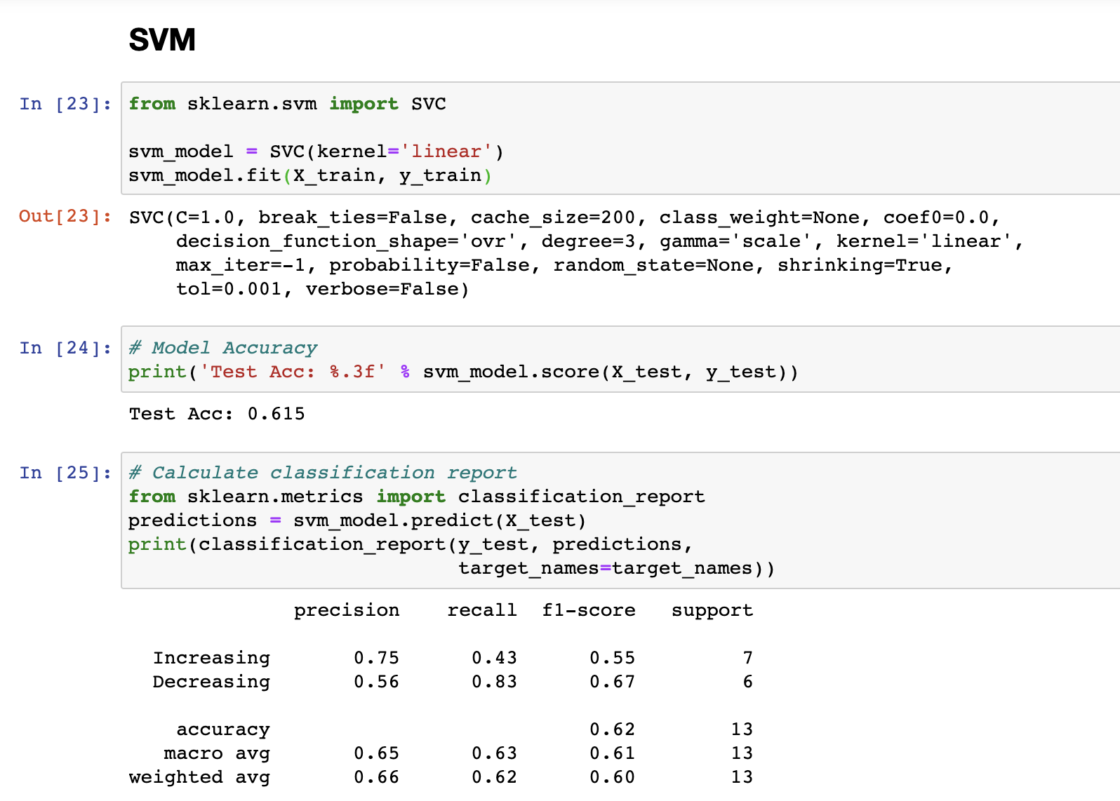
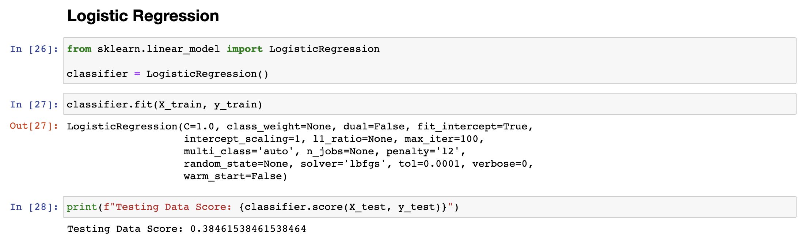
Machine Learning: Categorical
Notes:
Line spacing + Page numbers

Slide 10

Conclusions
We developed a model with existing data to predict what the foster care needs will be in the next 10 years from now. As you can see from the following selected states' results, we could predict that there will be an ever-increasing number of children in care over the next 10 years. If our predictions are on point then there will certainly be a correlated increased need for an expansion in foster care services.
This could be problematic based on the current issues and limitations that foster care services and child service agencies are experiencing now.
It is our hope that this data could provide information for families, child welfare agencies, and policymakers to understand the current and future needs, as well as the needs for the future.
Possible solutions such as the pooling of resources and budgets, streamlining of current processes, and even the possibility of the privatization of agencies could all lead to future solutions or changes that would ensure the safety, stability, and well-being of children and families.

Slide 11
Limitations and What Went Wrong
In-care data for each year is just a snapshot on September 30th, not an average for that year
Negative r-squared issue/greater than 1 for some states and foster data
Predictions assume that all other trends related to society remain stable (Political environment,
economic factors, demographics, etc.)
The COVID pandemic could skew the results for the future, since data available only goes through
2019
The COVID pandemic could also impact resources available for the next few years
Child maltreatment data was only available for one year
Data does NOT take into account the 23,000 children that age out of the system every year

Slide 12

Data Used
"Foster Trends in America”:
https://www.acf.hhs.gov/cb/resource/trends-in-foster-care-and-adoption
“Child Maltreatment 2011”
https://www.acf.hhs.gov/sites/default/files/documents/cb/cm11.pdf
“Voices for Children”
https://www.speakupnow.org/foster-care-statistics-resources/

Slide 13
Additional Resources
How you can help: Donating | Volunteering | Fostering | Adopting
KVC Kansas
KVC Kansas helps over 30,000 people annually through family preservation, family reunification, outpatient therapy, foster care, and adoption.
https://kansas.kvc.org/
DCCCA
DCCCA provides social and community services that improve the safety, health, and well being of those we serve.
https://www.dccca.org/
Cornerstones of Care
We work to keep children safe and families together through education, foster care & adoption, mental & behavioral support, family services, youth services, and community trainings.
https://cornerstonesofcare.org/
Adopt US Kids
AdoptUSKids is a national project that supports child welfare systems and connects children in foster care with families.
https://www.adoptuskids.org/
Missouri Baptist Children’s Home (LIGHT House Maternity Home)
The LIGHT House is for young pregnant ladies aged 12 - 21 who need a safe place to stay while pregnant, we offer full residential services. All residential services are provided free of charge.
https://www.mbch.org/ministries-by-affiliate/the-light-house/5
Notes:
Line spacing + Page numbers

Slide 14
Q & A
Notes:
Line spacing + Page numbers

